Slide 1




Zomato restaurant Data analysis
Team ID - 3387
Team Leader Name: Varsha Maurya
Team Member: Individual

Slide 2

Project Objectives
To develop a restaurant recommendation system that considers user preference for cost and rating using machine learning algorithms and python libraries.
Perform ETL(Extract –Transform-Load) on dataset.
Developed dashboard by using Power bi

Slide 3
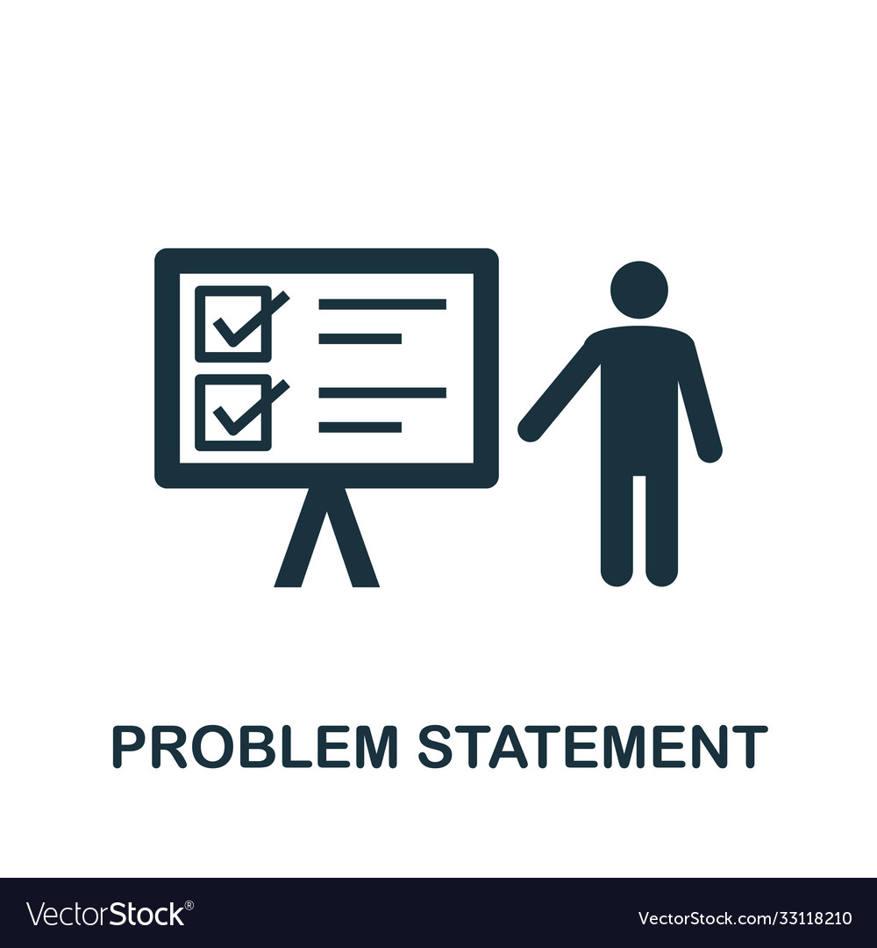
Problem Statement
Developing a Restaurant Recommendation System Based on Rating and Cost Preferences using machine learning.

Slide 4
Project overview - Introduction
A restaurant recommendation system based on rating and cost is designed to assist users in finding dining options that align with their preferences and budget constraints. Here's a brief overview of how such a system works:
User Input: The system begins by prompting the user to specify their preferences for restaurant ratings and cost. This input typically includes selecting a minimum rating threshold (e.g., 4 out of 5 stars) and indicating their preferred cost range (e.g., low-cost, medium-cost, high-cost).
Data Collection: The system relies on a comprehensive database of restaurants, which includes information such as restaurant names, ratings, cost categories, cuisines. This data obtained from Kaggle dataset.
Filtering Algorithm: Once the user preferences are collected, the system employs a filtering algorithm to narrow down the list of restaurants based on the specified criteria. Restaurants that fall below the minimum rating threshold or outside the user's cost range are filtered out, ensuring that only relevant options are considered.
Ranking and Recommendation: After filtering, the remaining restaurants are ranked based on factors such as rating, cost, and proximity to the user's location (if available). The top-ranked restaurants that meet the user's preferences are then recommended as potential dining choices.

Slide 5
Presentation of Results: The recommended restaurants are presented to the user in a clear and organized manner, typically through a user-friendly interface such as a mobile app or website. Each recommendation includes essential details such as the restaurant name, rating, cost category, cuisine type, and possibly reviews from other users.
User Feedback and Refinement: To enhance the recommendation accuracy, the system may incorporate feedback mechanisms where users can rate and provide feedback on recommended restaurants. This feedback is used to refine the recommendation algorithm and improve future recommendations.
Continuous Improvement: The restaurant recommendation system is continuously updated and refined to adapt to changing user preferences, new restaurant openings, and evolving dining trends. This may involve periodic updates to the restaurant database, algorithm enhancements, and improvements to the user interface.
Overall, a restaurant recommendation system based on rating and cost aims to provide users with personalized dining recommendations that meet their quality expectations and budget constraints, thereby enhancing their dining experience and satisfaction.

Slide 6
End User
General Consumers: Everyday individuals looking for dining options that match their preferences and budget. They might use the system when planning a meal out with friends or family, exploring new restaurants in their area, or seeking recommendations for special occasions.
Tourists: Travelers visiting a new city or region who are unfamiliar with local dining options. They rely on the system to discover highly-rated restaurants that fit within their budget constraints and offer a memorable dining experience.
Food Enthusiasts: Individuals passionate about food who enjoy exploring different cuisines and dining experiences. They use the system to discover hidden gems, upscale dining establishments, or trending food spots that offer exceptional quality at a reasonable cost.
Busy Professionals: People with hectic schedules who rely on quick and convenient dining options. They use the system to find nearby restaurants with high ratings and affordable prices, making it easy to grab a meal during lunch breaks or after work.

Slide 7

Wow Factor in Solution
Hyper-Personalization
Dynamic Pricing Insights
Interactive Recommendation Experience
Predictive Analysis
By incorporating these wow factors into the development of a restaurant recommendation system based on customer rating and cost preferences, the system can deliver a truly exceptional and unforgettable user experience that delights and surprises users at every turn.

Slide 8
Modelling
Step 1.
Collecting Zomato restaurant Data
Step 2.
Exploratory data analysis
Step 3.
Machine Learning algo.
Step 4.
Creating dashboard
data from Kaggle dataset
Using pandas, seaborn and matplotlib
Decision tree classifier
Using power bi

Slide 9
Result / Outcomes
Improved User Experience: Users will benefit from a more intuitive and efficient restaurant recommendation system that considers their preferences for both rating quality and cost affordability. This will result in greater satisfaction and confidence in their dining choices.
Personalized Recommendations: The recommendation system will provide personalized recommendations tailored to each user's unique preferences, leading to more relevant and meaningful dining experiences.
Increased User Engagement: With features such as user feedback mechanisms and social integration, the system will foster greater user engagement, encouraging users to interact with the platform and share their dining experiences with others.
Enhanced Business Insights: Restaurant owners and managers will gain valuable insights into consumer preferences, market trends, and competitive benchmarks, enabling them to optimize their offerings and improve customer satisfaction.
Optimized Revenue Streams: By dynamically adjusting pricing and offering promotions based on demand and feedback, restaurants can optimize their revenue streams and attract a larger customer base.
Expansion Opportunities: The recommendation system can be expanded to encompass additional criteria such as dietary preferences, ambiance, and special features, catering to a broader range of user needs and preferences.

Slide 10
Conclusion
The development of a restaurant recommendation system based on rating and cost preferences presents a significant opportunity to enhance the dining experience for consumers while providing valuable insights for restaurant owners and managers. Through the implementation of intuitive user interfaces, comprehensive databases, sophisticated filtering algorithms, and user feedback mechanisms, we have endeavored to create a solution that addresses the diverse needs of our target audience.
By prioritizing user preferences for both rating quality and cost affordability, we aim to deliver personalized recommendations that inspire confidence and satisfaction among our users. The presentation of clear and organized recommendations, coupled with ongoing efforts to improve recommendation accuracy and user experience, underscores our commitment to delivering value at every stage of the user journey.
Furthermore, the restaurant recommendation system holds promise not only for individual consumers seeking dining options
but also for businesses within the restaurant industry. Insights gleaned from user data can inform strategic decision-making,
allowing restaurant owners and managers to optimize their offerings, improve customer satisfaction, and stay competitive
in a dynamic market landscape.
As we move forward, we remain dedicated to continuous refinement and innovation, guided by feedback from our users
and stakeholders.
By leveraging emerging technologies, harnessing the power of data analytics, and fostering collaborative partnerships,
we are confident in our ability to further enhance the restaurant recommendation experience and drive positive outcomes for both
consumers and businesses alike. Thank you for joining us on this journey towards culinary discovery and excellence.

Slide 11
Future Perspective
Integration of Advanced Technologies: Explore the integration of advanced technologies such as machine learning and natural language processing to further enhance recommendation accuracy. These technologies can enable the system to better understand user preferences and provide more personalized recommendations over time.
Dynamic Pricing and Promotions: Implement features that allow restaurants to dynamically adjust their pricing and offer promotions based on demand, feedback, and market trends. This could incentivize users to try new restaurants and help restaurants optimize their revenue streams.
Multi-Criteria Recommendations: Expand the recommendation system to consider additional criteria such as dietary preferences, ambiance, and special features (e.g., outdoor seating, pet-friendly). This would provide users with more comprehensive and tailored recommendations to suit their preferences.
Social Integration: Integrate social media platforms to enable users to share their dining experiences, recommendations, and reviews with their social networks. This social aspect could enhance user engagement and expand the reach of the recommendation .sys
Augmented Reality (AR) Experiences: Develop AR features that allow users to visualize restaurant interiors, view menu items, and even virtually experience the ambiance before making a reservation. This immersive experience could help users make more informed decisions and enhance their overall dining experience.
Partnerships and Collaborations: Forge partnerships with food delivery services, reservation platforms, and other relevant stakeholders to offer seamless integration and a comprehensive dining experience. This could include features such as one-click reservations or exclusive discounts for users of the recommendation system.

Slide 12
Thank you...!
Notes:
12

